Slide 1
Data Analysis on Gun Violence Dataset Collaborators: Yaswanth Akkisetty Rajashekar Reddy Dinasarapu

Slide 2
Introduction:
The Gun Violence dataset represents a comprehensive collection of information related to incidents involving firearms in various contexts. This dataset is a valuable resource for understanding the magnitude, patterns, and dynamics of gun-related incidents, including their locations, impact, circumstances, and other related factors. It is instrumental in the domains of public safety, criminal justice, policy formulation, and advocacy, providing crucial insights into the complex issue of gun violence.
At its core, the dataset typically includes details such as the date and time of the incident, the location (city, state, and coordinates), the number of casualties (fatalities and injuries), the type of gun violence event (e.g., mass shooting, suicide, robbery), the involvement of law enforcement, and various contextual details. Additionally, the dataset might encompass information regarding the victims, the suspects, and the firearms used.
Furthermore, the dataset can be leveraged to raise public awareness, educate communities, and drive informed public discourse about gun violence and its implications. Understanding the multifaceted nature of gun violence is essential for fostering a safer society and promoting evidence-driven solutions to mitigate this critical issue. The Gun Violence dataset plays a pivotal role in achieving these objectives and advancing research and policy efforts aimed at reducing the devastating impact of gun violence.

Slide 3
Problem Statements:
Total number of cases registered per each state?
Compare and analyze the gun violence incidents in urban (city) and rural (county) areas?
Determine if there's any correlation between the presence of specific representatives and the frequency or severity of incidents.
Investigate whether certain demographic groups are more vulnerable or prone to involvement in such incidents.
Determine if incidents involving stolen guns have distinct characteristics compared to incidents with legally owned guns.
Analyze whether certain geographical areas are more susceptible to gun violence.
Determine which age groups are more involved in these cases.
Determine the total number of individuals killed in each state.
Determine which gender is primarily involved in this violence.
Which year had the highest number of cases?

Slide 4
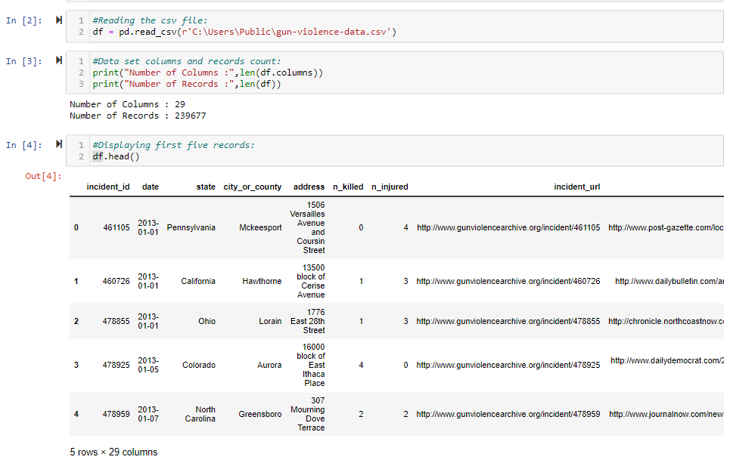

Dataset Details:
This dataset has 29 columns and 239678 records. The dataset enables analysis and investigation of numerous elements of gun violence, such as the frequency and distribution of occurrences, the link with sociodemographic characteristics, the impact on communities, and the efficacy of various preventative and intervention efforts. It provides as a foundation for evidence-based policymaking, assisting legislators, researchers, and activists in developing effective strategies to lessen the negative impacts of gun violence on society.

Slide 5
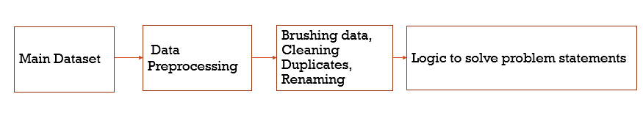
Data Pipeline:

Slide 6
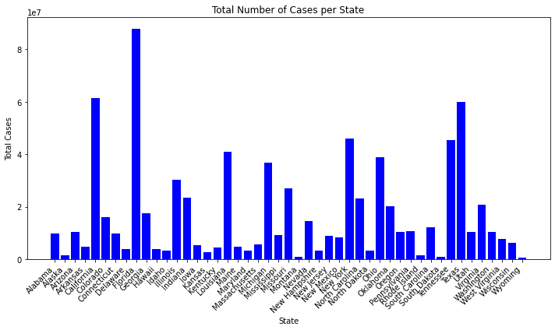
Total number of cases registered per each state?

Slide 7
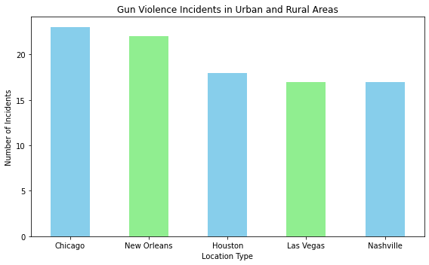
Compare and analyze the gun violence incidents in urban (city) and rural (county) areas?

Slide 8
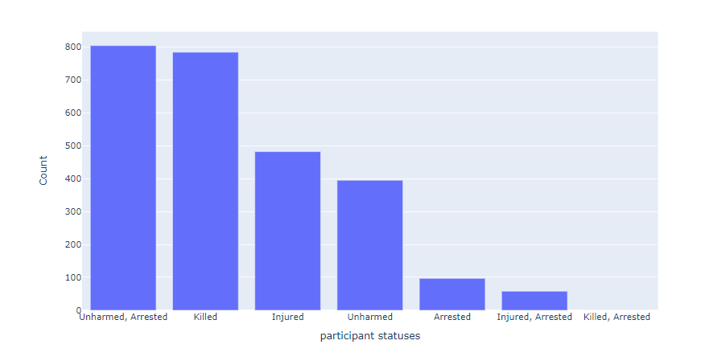
Determine if there's any correlation between the presence of specific representatives and the frequency or severity of incidents.

Slide 9
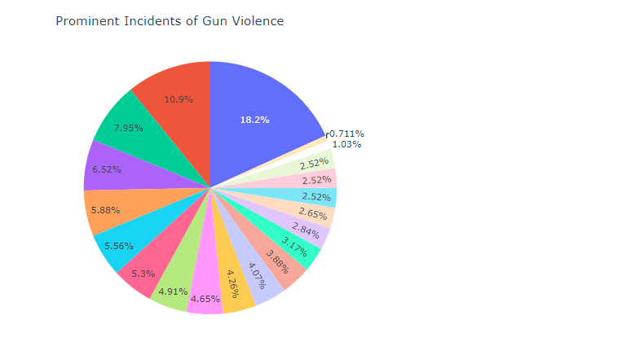
Investigate whether certain demographic groups are more vulnerable or prone to involvement in such incidents. Institutional/Group/Business has more involvement.

Slide 10
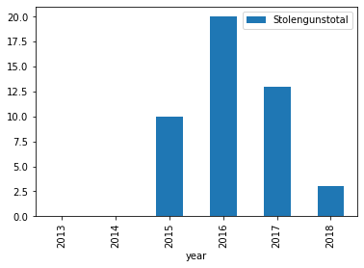
Determine if incidents involving stolen guns have distinct characteristics compared to incidents with legally owned guns.

Slide 11
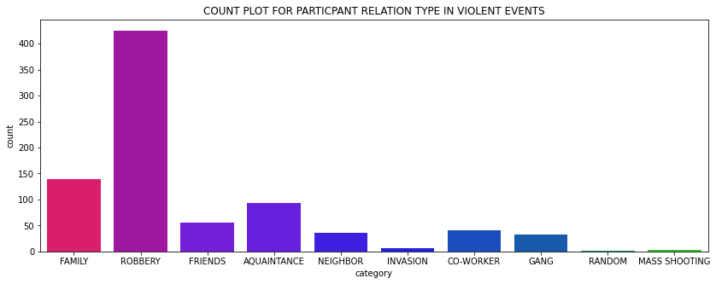
Analyze whether certain geographical areas are more susceptible to gun violence.

Slide 12
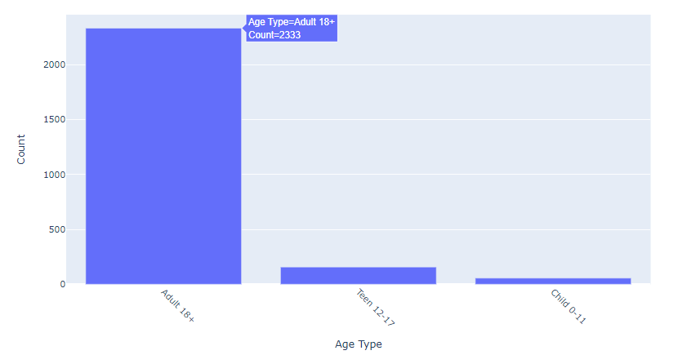
Determine which age groups are more involved in these cases.

Slide 13
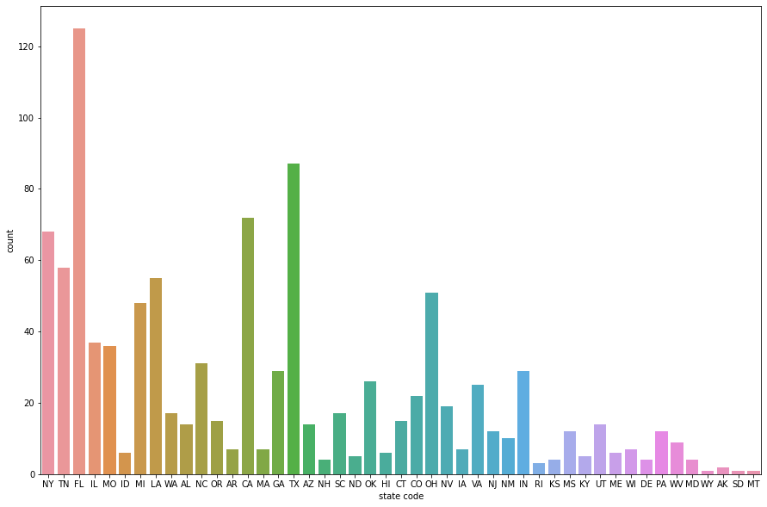
Determine the total number of individuals killed in each state.

Slide 14
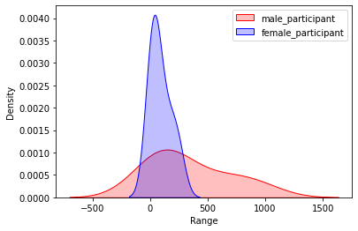
Determine which gender is primarily involved in this violence.

Slide 15
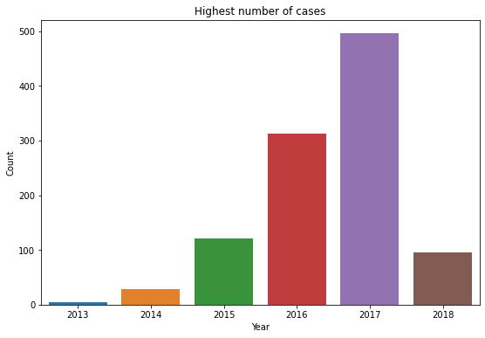
Which year had the highest number of cases?

Slide 16
Thank You

